Slide 1
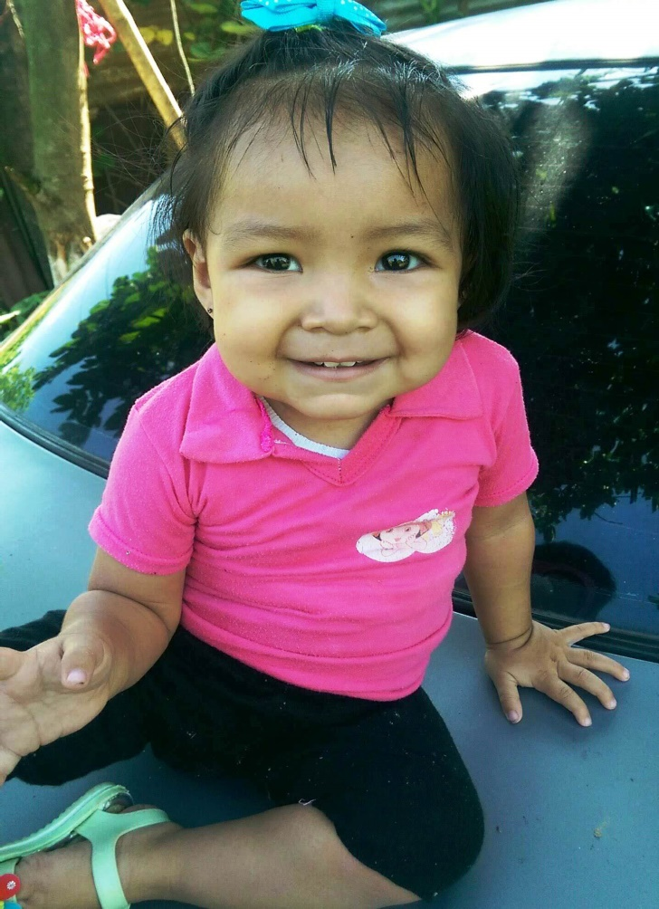
As A Little Child
Mark 10:13-16
Notes:
Febe, hija de Deisy y Anslemo

Slide 2
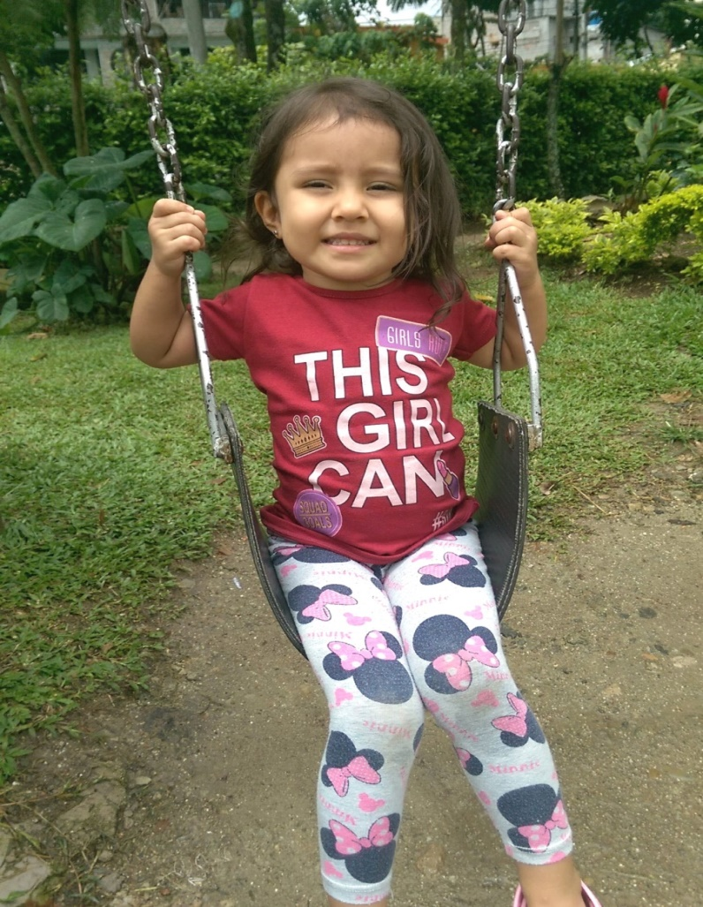
Humility
Matt. 18:1-5
Lk.18:9-14
Notes:
Elizabeth, hija de Diego y Andrea

Slide 3
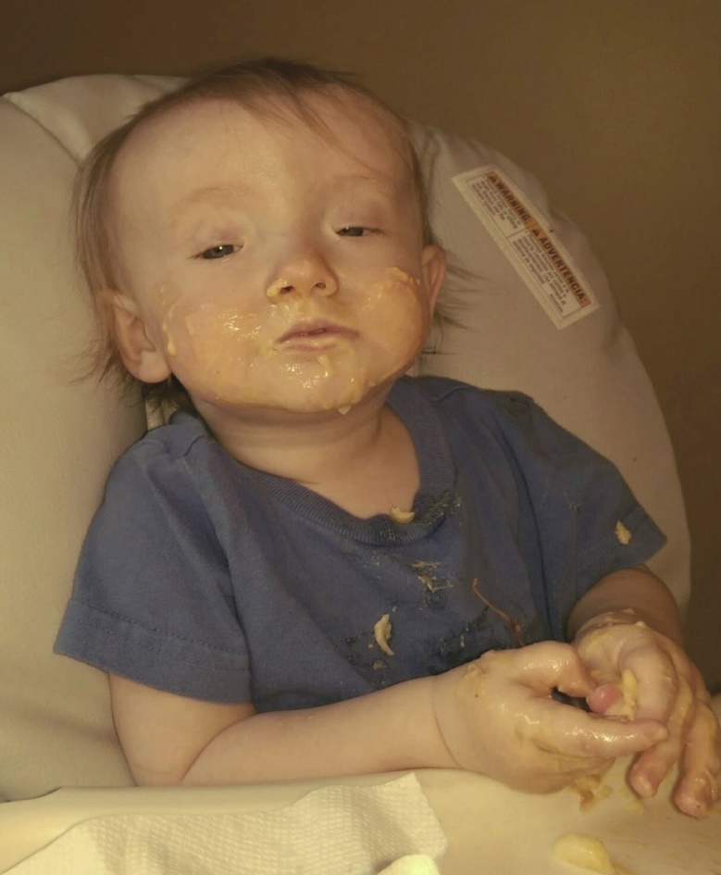
The Desire For Food
1 Peter 2:1-2
Mt.5:6
Notes:
Elijah Bowling

Slide 4
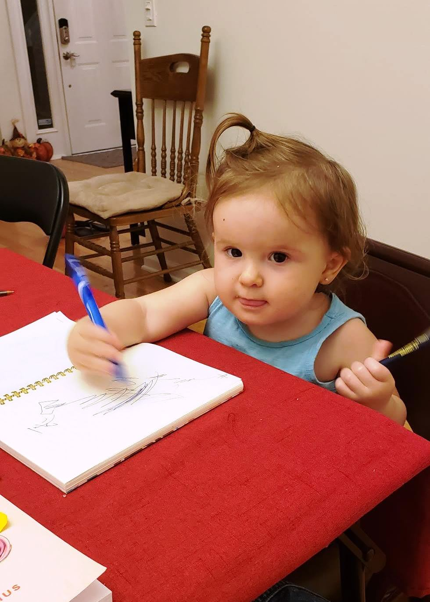
Docile in Teaching
Matt.11:25-26
Acts 8:30ff
Acts 17:11
Acts 10:30-33
Notes:
ready to accept control or instruction; submissive.

Slide 5
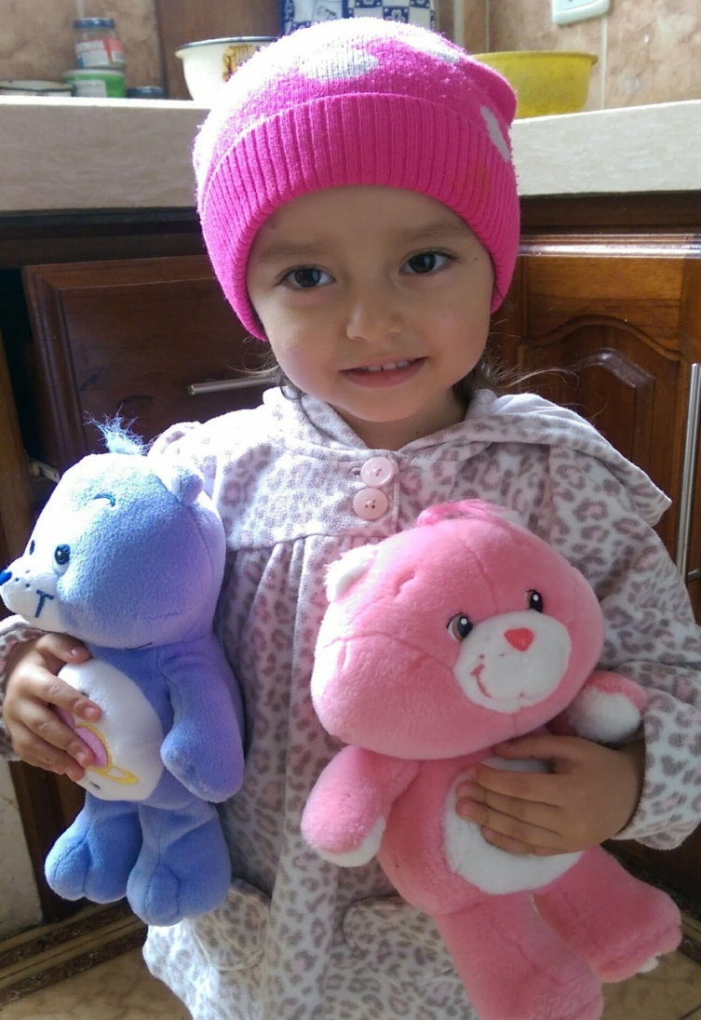
Sincere
Matt. 21:15-16
Phil.1:10
Notes:
Betsy

Slide 6
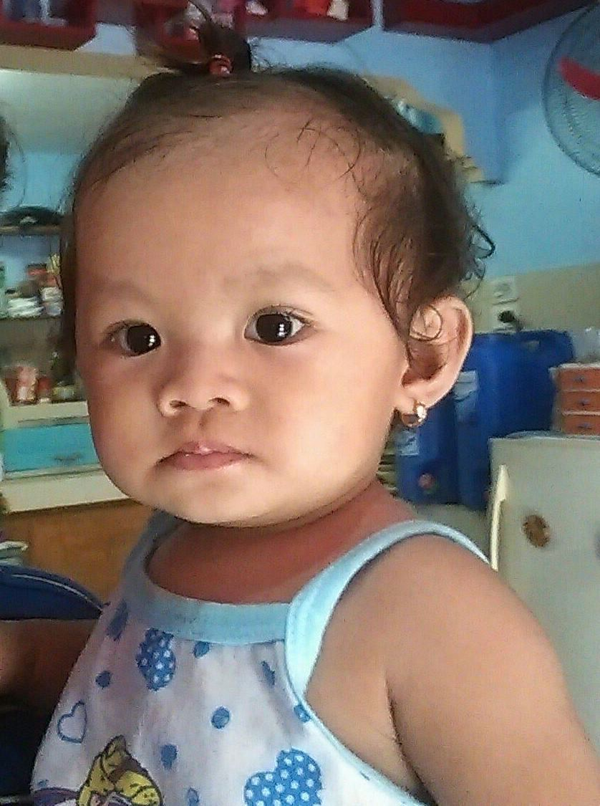
Be Without Malice
1 Cor. 14:20
Matt.18:21ff
Notes:
Tay-Tay Philippines

Slide 7
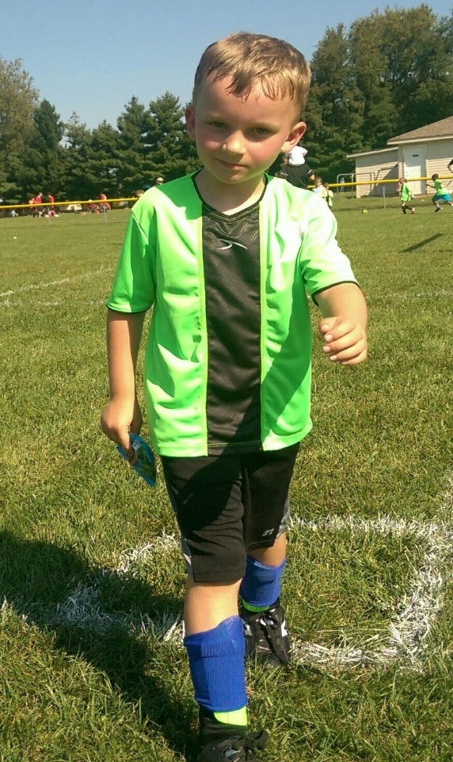
Persistence
Luke 11:1-11

Slide 8
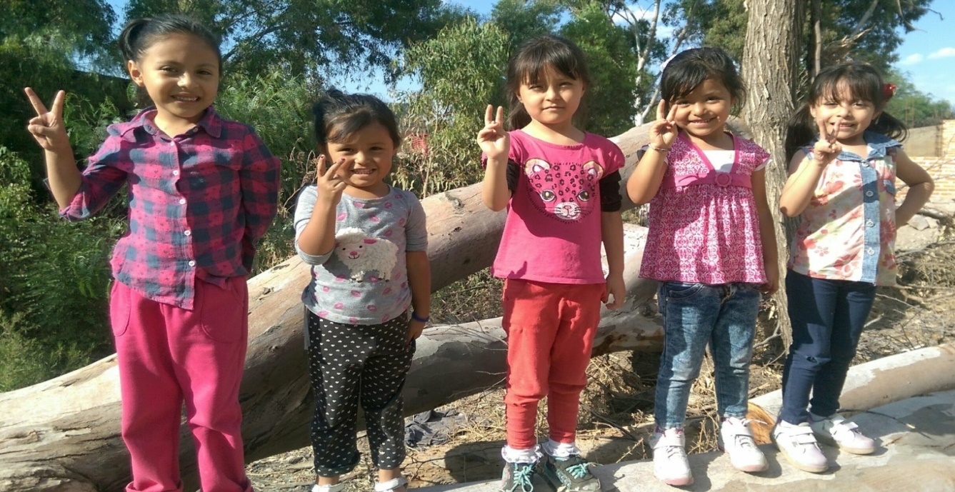
Imitators
Eph. 5:1
Notes:
Moy’s 5 granddaughters, San Luis Potosi

Slide 9
“Verily I say unto you, Whosoever shall not receive the kingdom of God as a little child, he shall not enter therein.” Mar. 10:15
Notes:
Hattie

Slide 10
God Has a Plan to Save Man
Hear the Gospel of Christ, Acts 18:8
Believe in Jesus Christ, Rom.5:1
Repent and Turn to God, Luke 24:47
Confess Jesus Before Men, Acts 8:37
Be Baptized for the Remission of Sins, Ac.2:38
---------------------------------
Be Thou Faithful Unto Death, Rev.2:10
If Err From The Faith: Repent and Pray God, Acts 8:22

