Slide 1
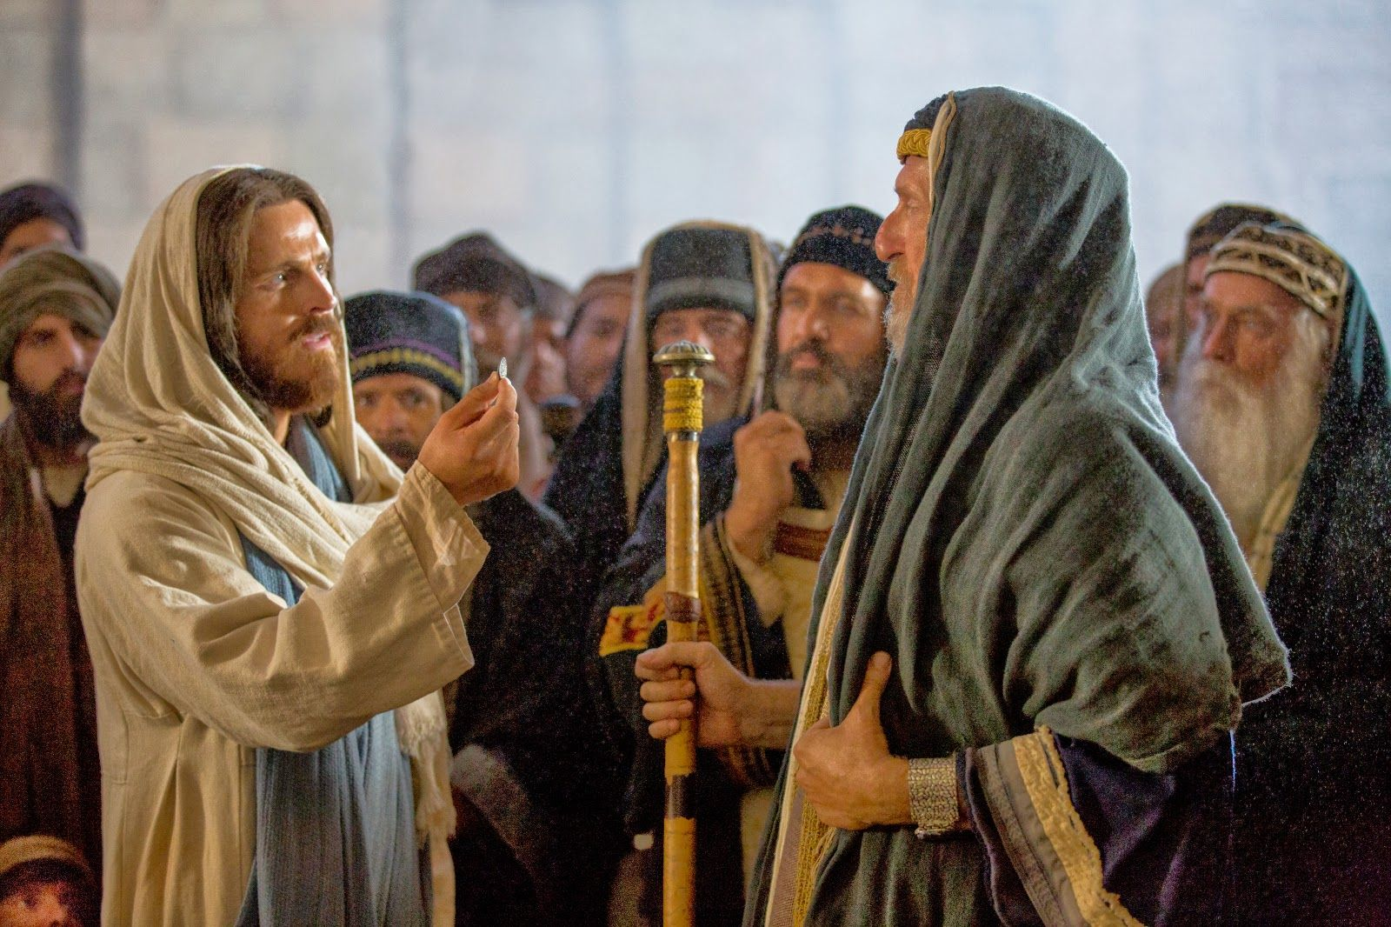
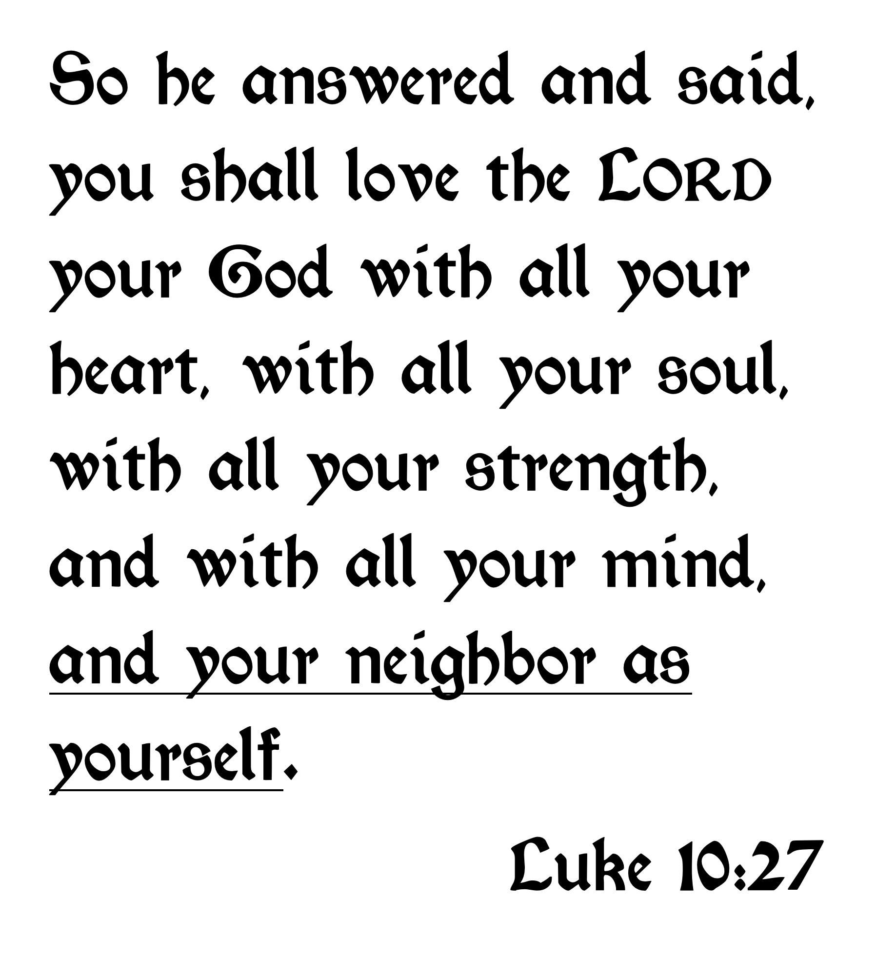
The Scribe Answered
Matthew 19:19
Matthew 22:39
Mark 12:31
Romans 13:9
James 2:8

Slide 2
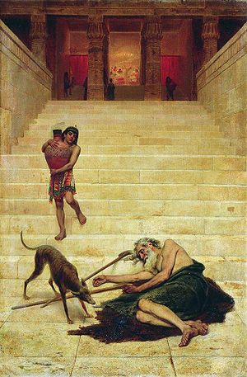
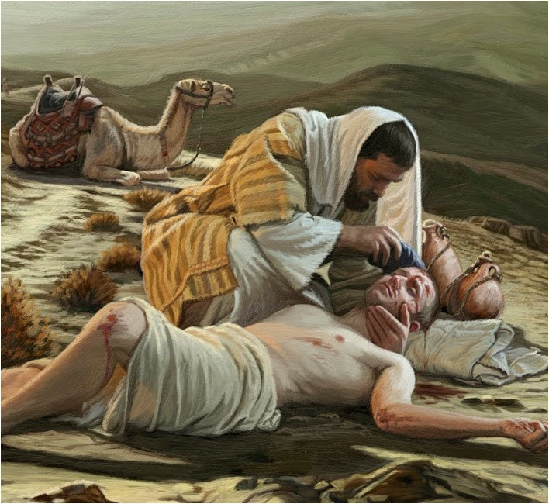
Luke 7:36-50
Luke 16:19-31
Luke 10:25-37

Slide 3
THE TRAMP ON THE STREET
Only a tramp was Lazarus sad fate
He who lay down at the rich man’s gate
He begged for some crumbs from the rich man to eat…
…But they left him to die—like a tramp on the street

Slide 4
Luke 7:36-50
Luke 16:19-31
Luke 10:25-37

Slide 5
“A woman in the city who was a sinner”
She was somebody’s daughter.
Possibly someone’s sister.
Once a 10-year-old girl with a mom and dad; with hopes, dreams and a future.
Unknown how she ended up this way.
Simon saw a “Tramp in the street,” but Jesus saw one created in the image of God—needing compassion, help and forgiveness.

Slide 6
Luke 7:36-50
Luke 16:19-31
Luke 10:25-37

Slide 7
A dirty, disgusting Samaritan (hated race).
Deserving of what he got.
A Tramp in the street.
But the traveler bore the image of God,
Somebody’s someone; a son, a brother, a husband, a father, a neighbor!

Slide 8
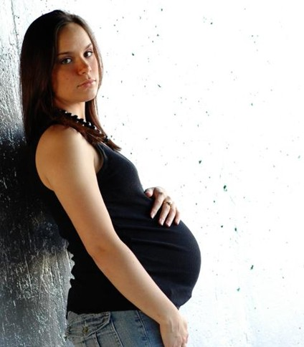
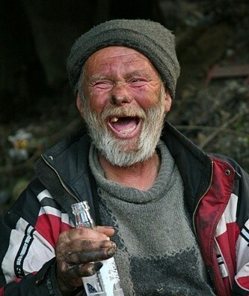
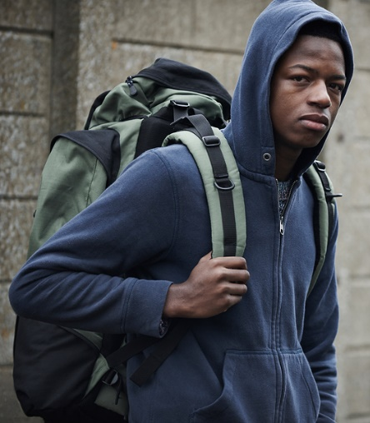
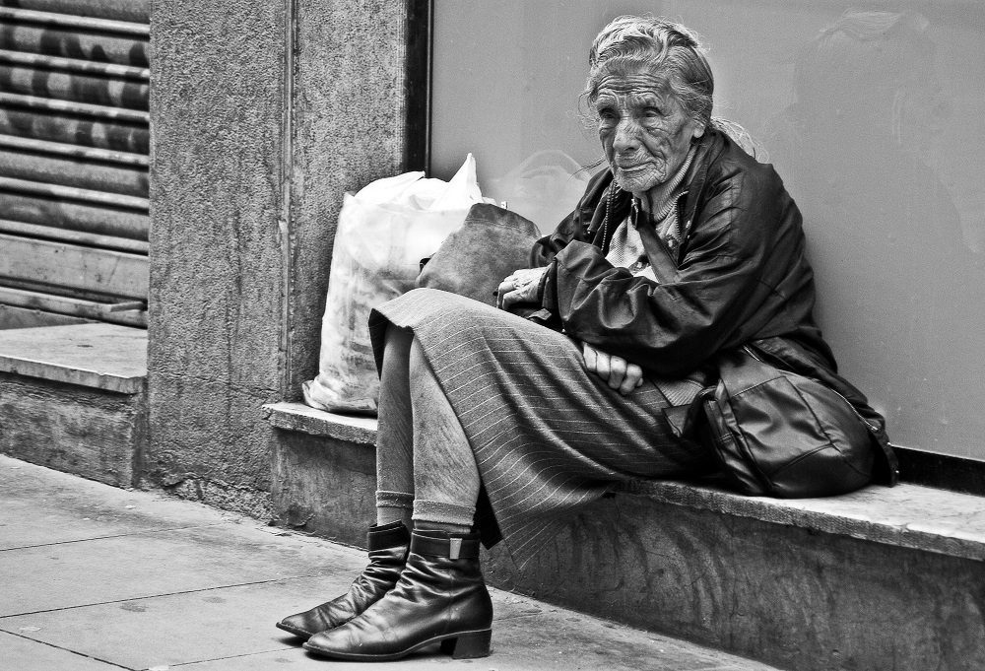
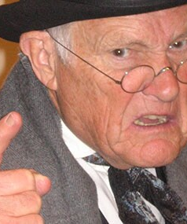

Slide 9
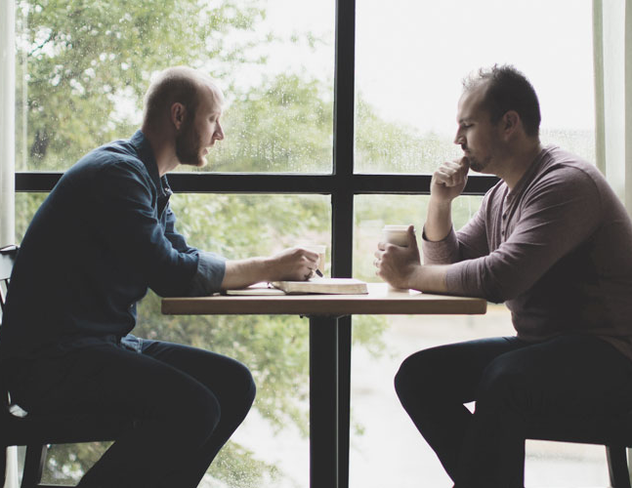
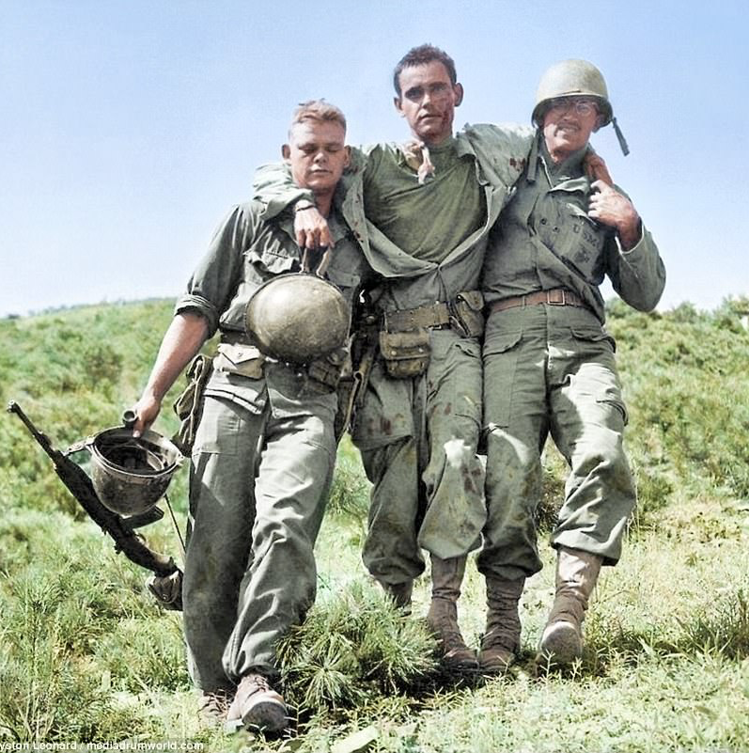
Loving Myself,
Seeing Myself in my Neighbor,
Always Speaking the Truth to my Neighbor,
Never Being a Stumbling-Block to my Neighbor.

